Slide 1
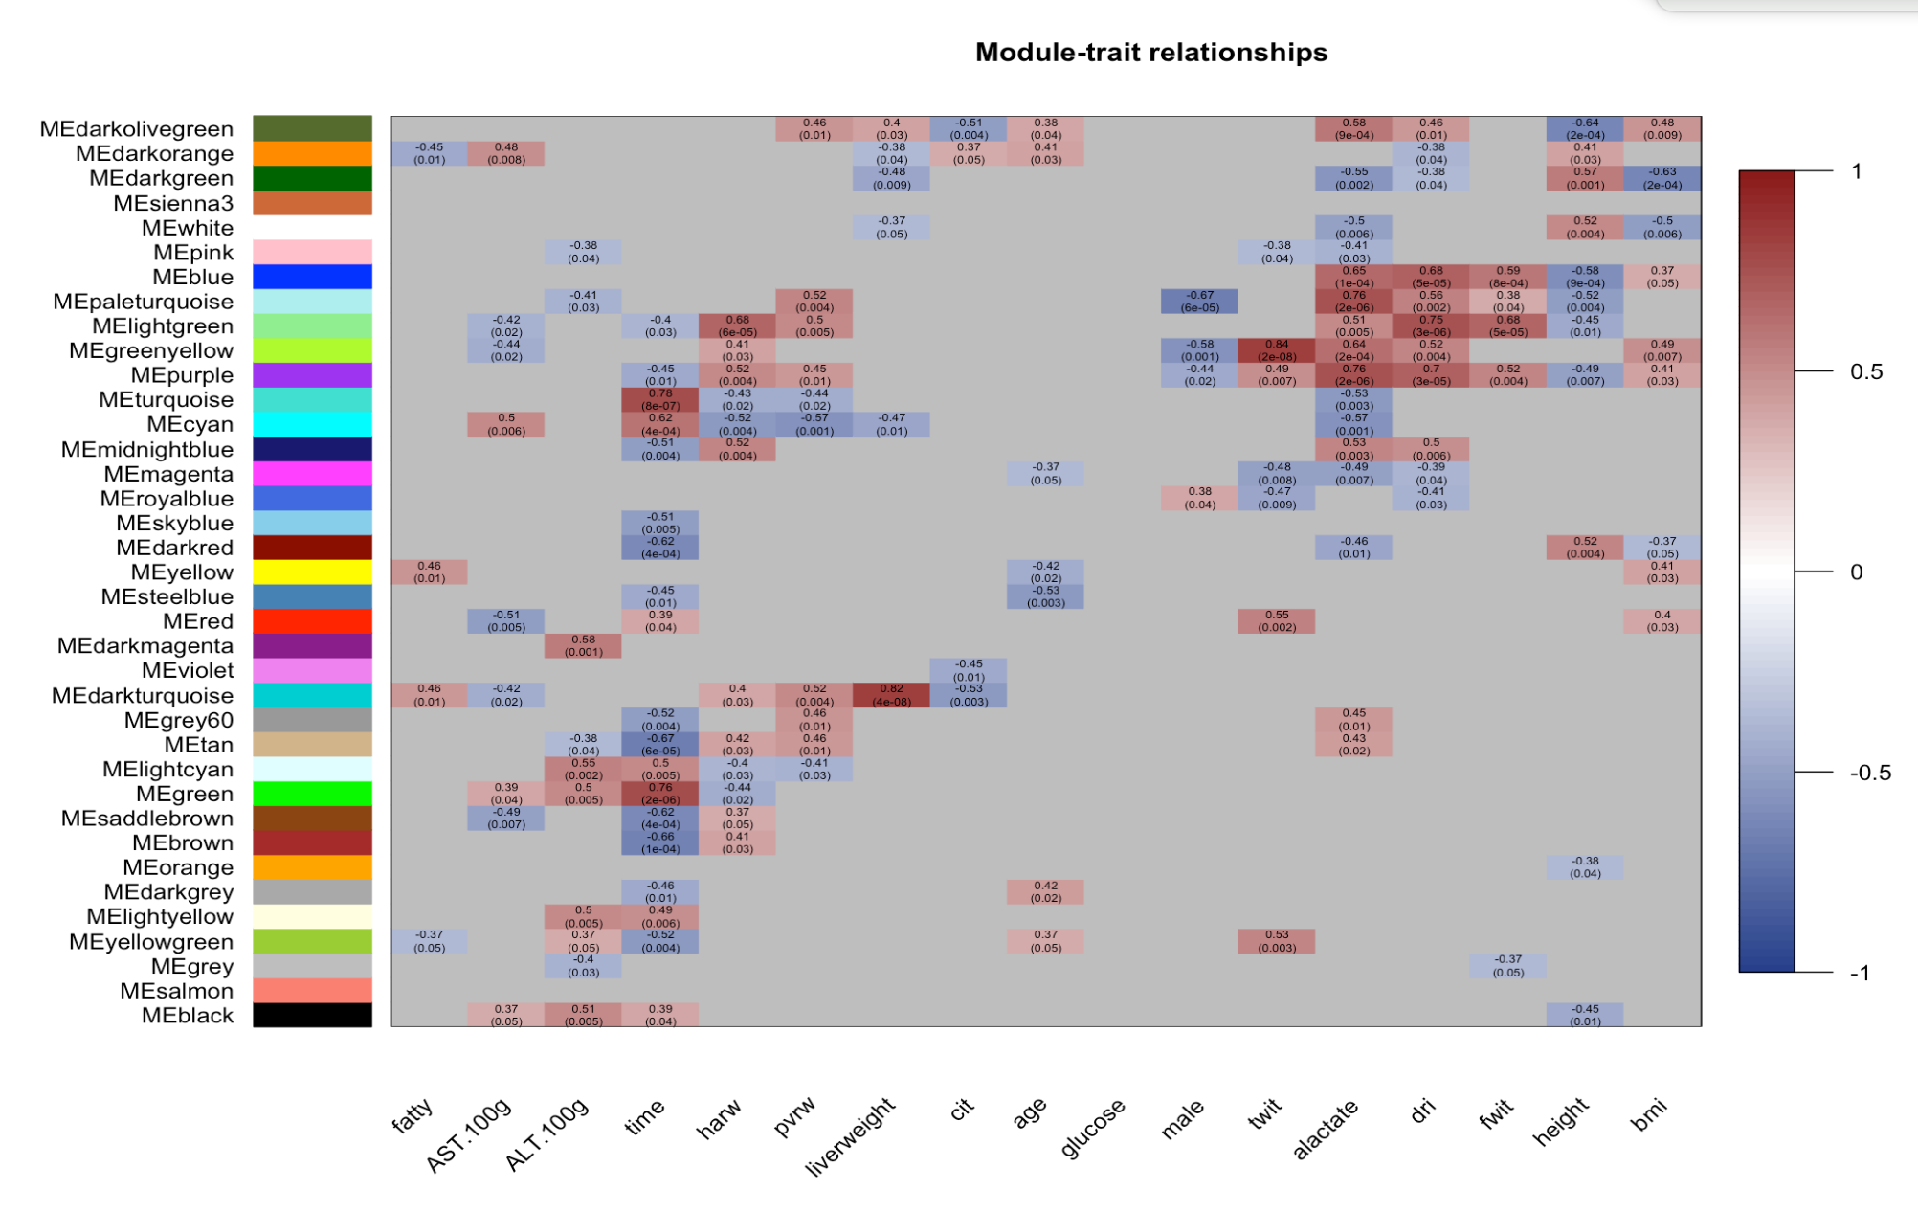
correlation between module eigengene and trait
Steatosis
AST
ALT
Time
HArw
PVrw
CIT
Glucose
Sex
TWIT
Lactate
DRI
FWIT
Height
BMI
Liver Weight
Donor Age

Slide 2
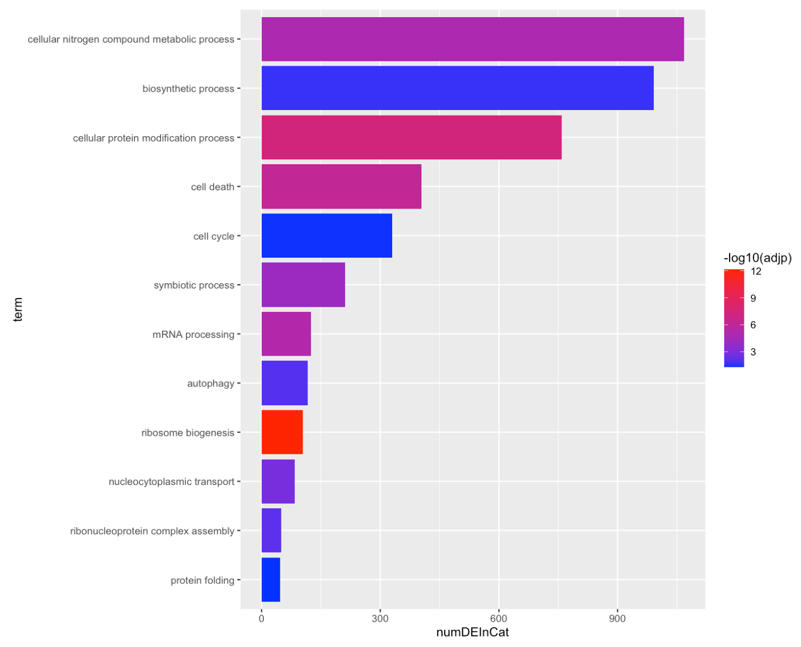
Cellular nitrogen compound metabolic process
Biosynthetic process
Cellular protein modification process
Cell death
Cell cycle
Symbiotic process
GOslim Biological Process
mRNA processing
Autophagy
Ribosome biogenesis
Nucleocytoplasmic transport
Ribonucleoprotein complex assembly
Protein folding
Total sig. DEG in Category

Slide 3
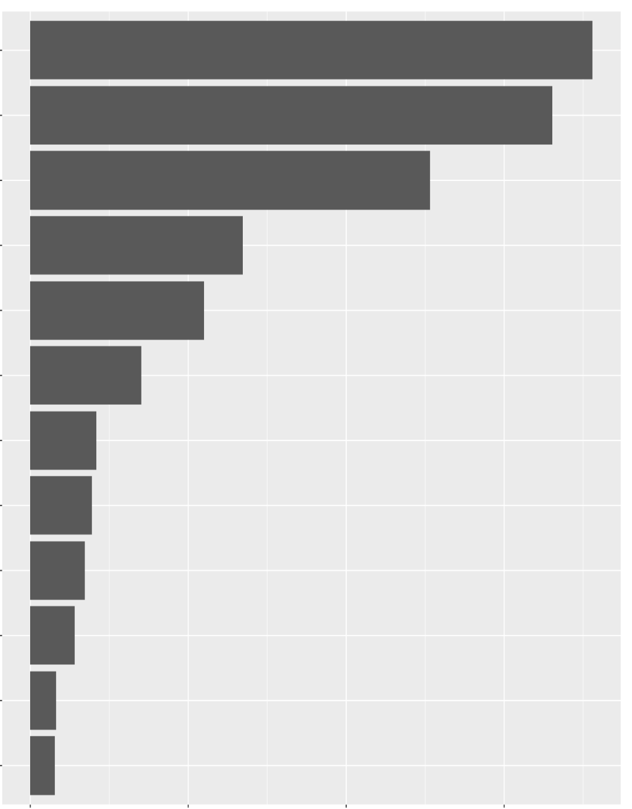
Cellular nitrogen compound metabolic process
Biosynthetic process
Cellular protein modification process
Cell death
Cell cycle
Symbiotic process
GOslim Biological Process
mRNA processing
Autophagy
Ribosome biogenesis
Nucleocytoplasmic transport
Ribonucleoprotein complex assembly
Protein folding
0
300
600
900
Total sig. DEG in Category

Slide 4
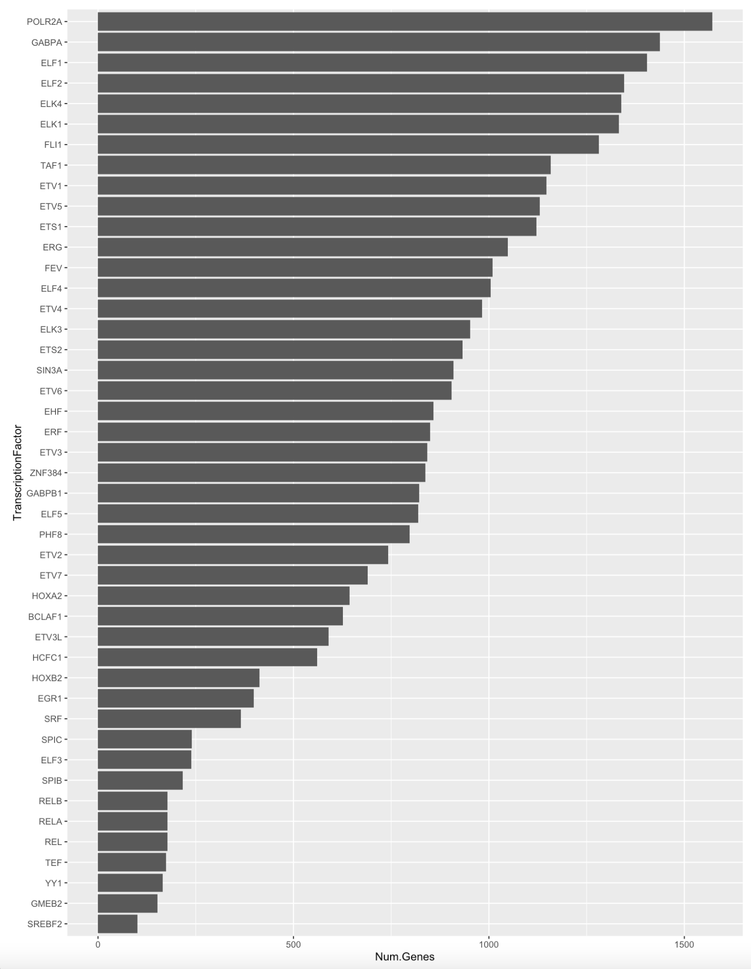
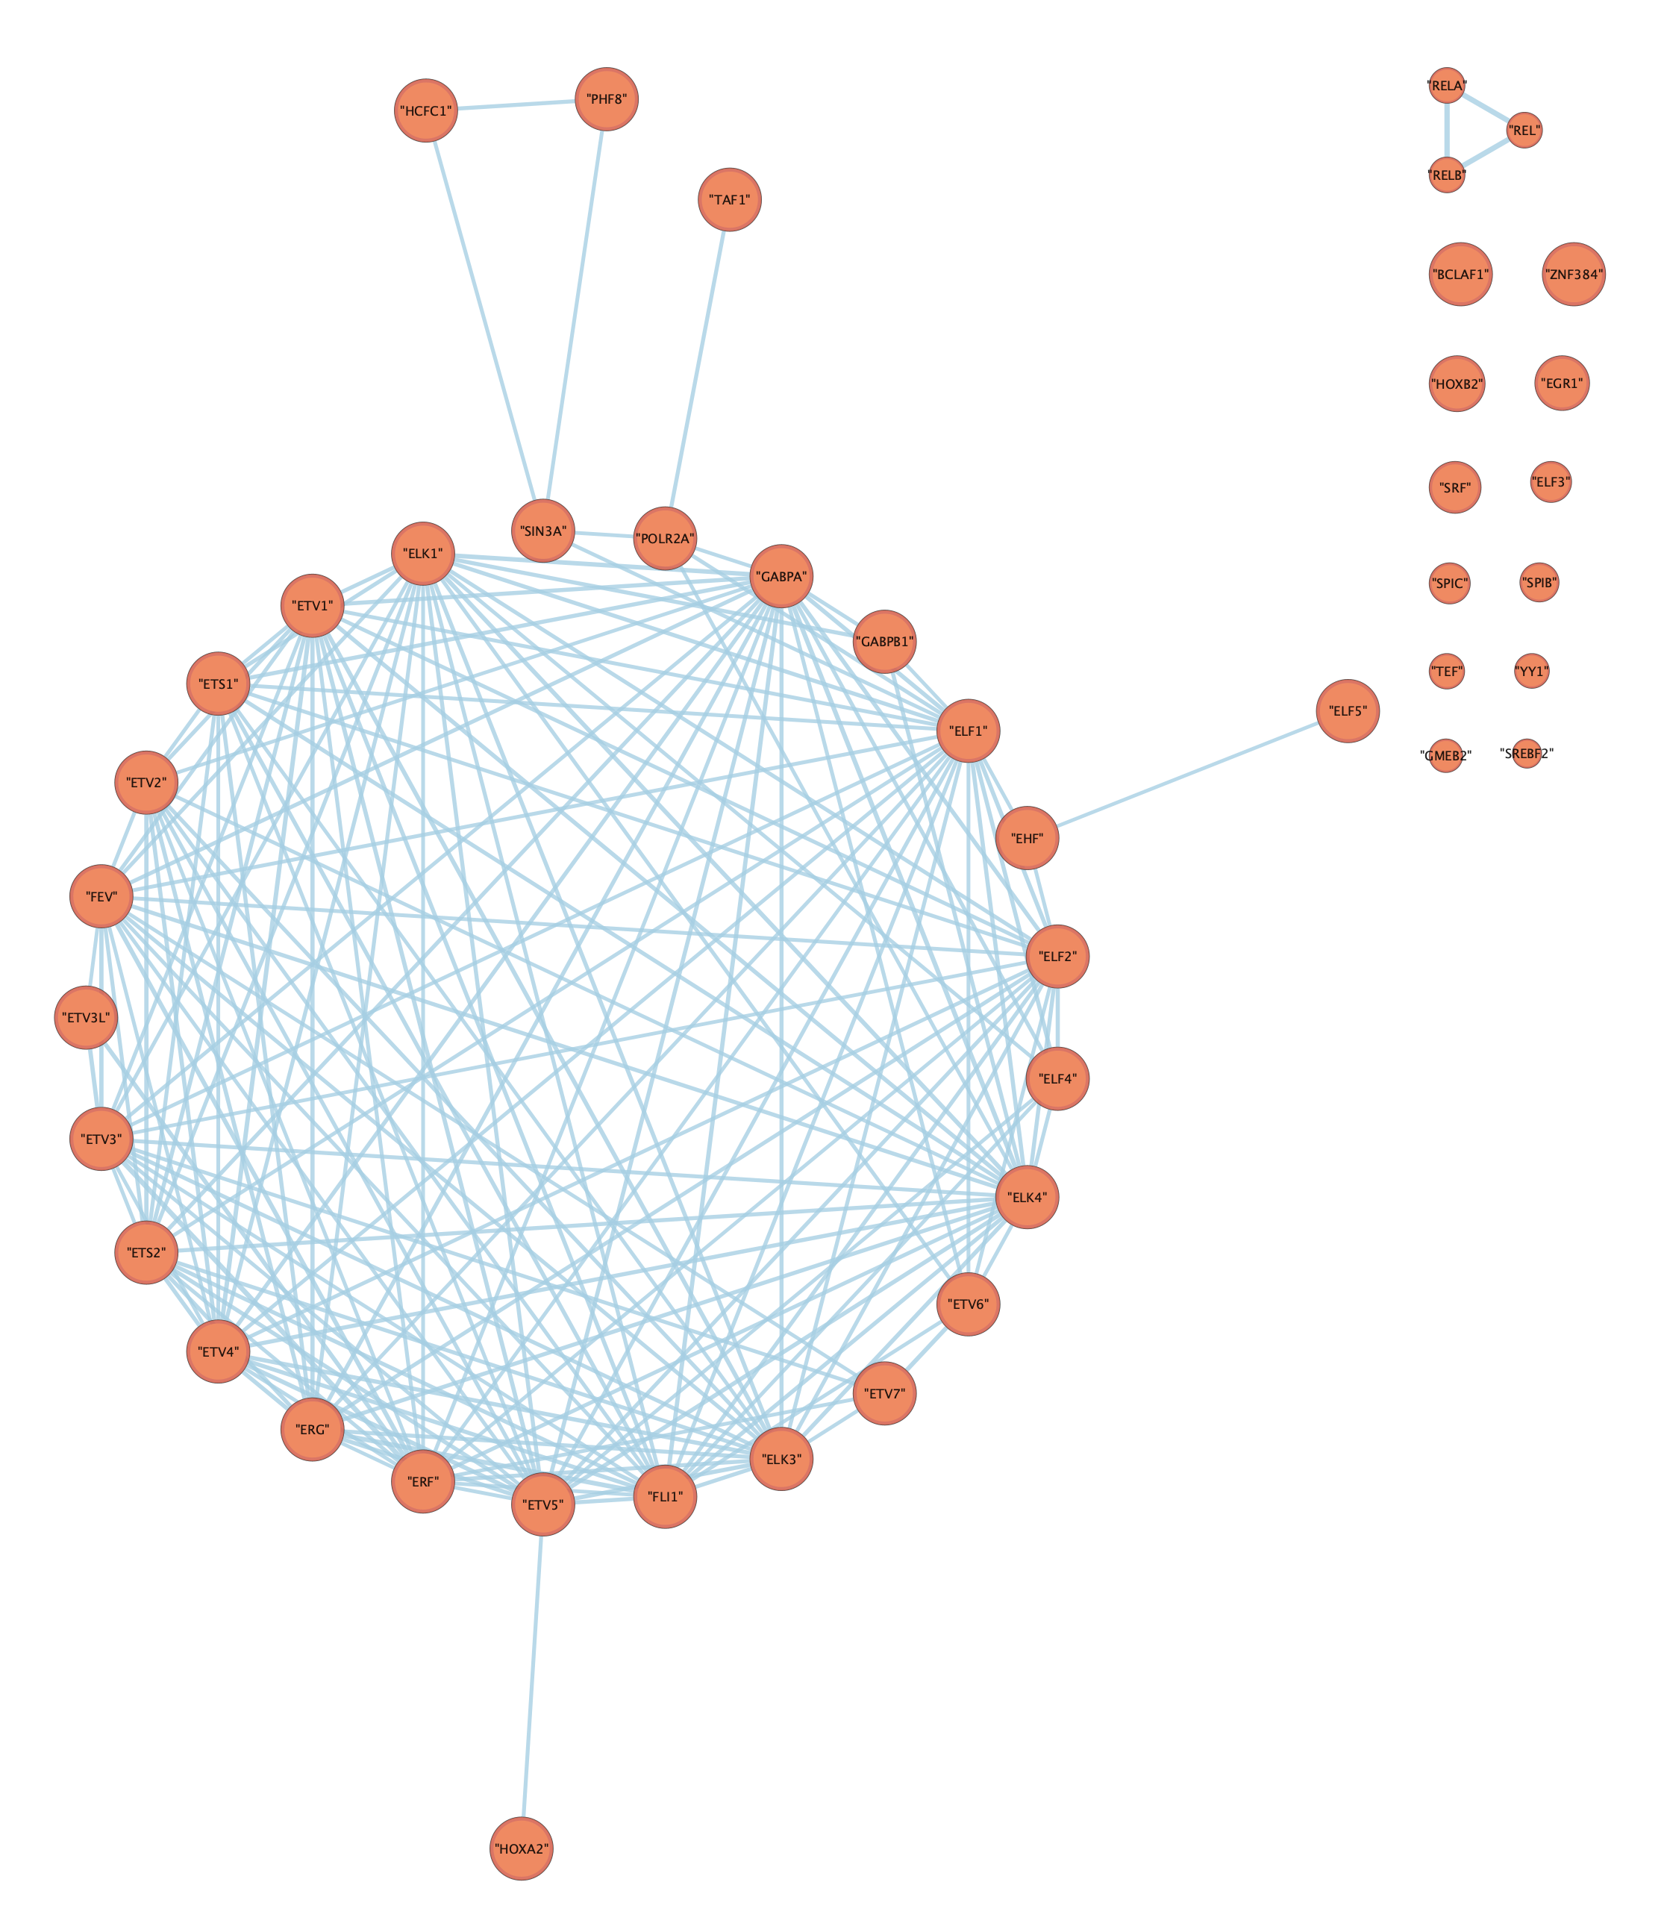

Slide 5
